Slide 1
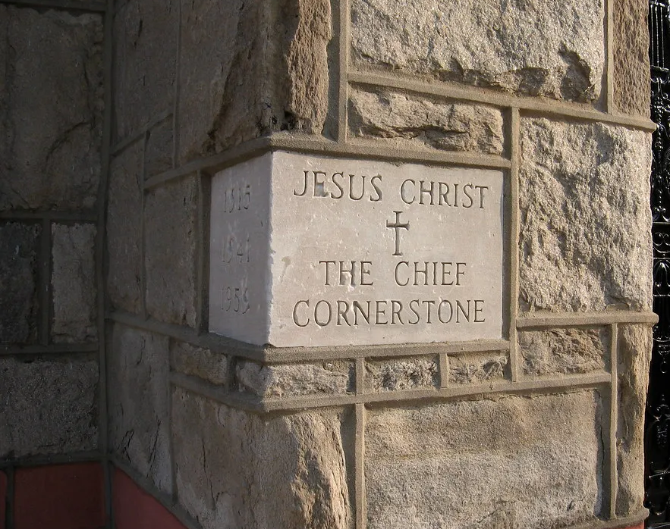
Cornerstone

Slide 2
My hope is built on nothing less
Than Jesus' blood and righteousness
I dare not trust the sweetest frame
But wholly trust in Jesus' name

Slide 3
Christ alone, Cornerstone
Weak made strong in the Savior's love
Through the storm
He is Lord Lord of all

Slide 4
When darkness seems to hide His face
I rest on His unchanging grace
In every high and stormy gale
My anchor holds within the veil
My anchor holds within the veil

Slide 5
Christ alone, Cornerstone
Weak made strong in the Savior's love
Through the storm
He is Lord Lord of all

Slide 6
He is Lord
Lord of all

Slide 7
Christ alone, Cornerstone
Weak made strong in the Savior's love
Through the storm
He is Lord Lord of all

Slide 8
When he shall come with trumpet sound
Oh may I then in Him be found
Dressed in His righteousness alone
Faultless, stand before the throne

Slide 9
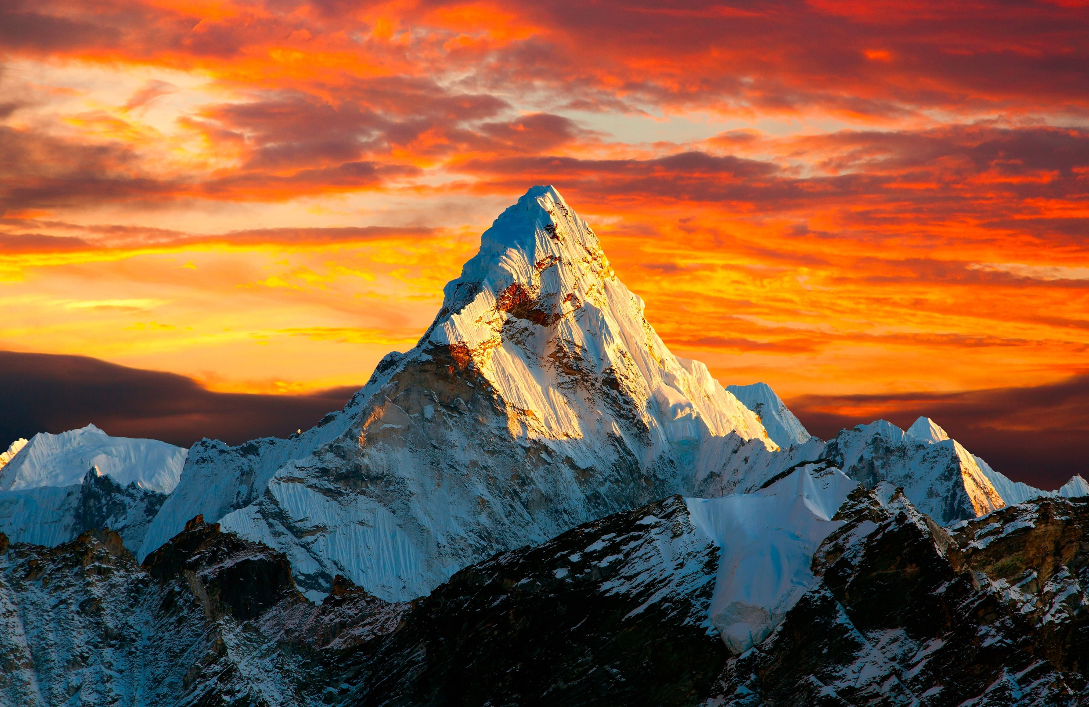
Good Good Father

Slide 10
Oh, I’ve heard
A thousand Stories
Of what they
Think you’re like

Slide 11
But I’ve heard
The tender whisper of love
In the dead of night
And you tell me
That you’re pleased
And that I’m never alone

Slide 12
You’re a good good Father
It’s who you are
And I’m loved by you
It’s who I am

Slide 13
Oh, and I’ve seen
Many searching
For answers
Far and wide

Slide 14
But I know
We’re all searching for answers
Only you provide
Cause you know just
What we need before we
Say a word

Slide 15
You’re a good good Father
It’s who you are
And I’m loved by you
It’s who I am

Slide 16
Cause you are perfect
In all of your ways
You are perfect
In all of your ways
To us

Slide 17
Oh, it’s love
So undeniable
I, I can
Hardly speak

Slide 18
Peace so
Unexplainable
I, I can
Hardly think

Slide 19
As you call me
Deeper still
Into Love
Love Love

Slide 20
You’re a good good Father
It’s who you are
And I’m loved by you
It’s who I am

Slide 21
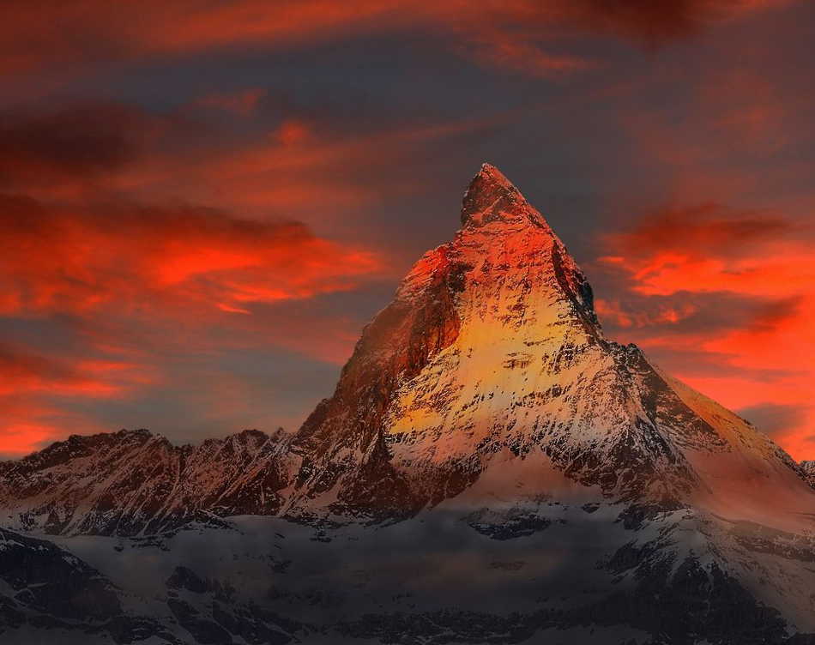
Hymn of Heaven

Slide 22
How I long to breathe the air of Heaven
Where pain is gone
and mercy fills the streets

Slide 23
To look upon the one
who bled to save me
And walk with Him for all eternity

Slide 24
There will be a day
When all will bow before Him
There will be a day
When death will be no more

Slide 25
Standing face to face
With He who died and rose again
Holy holy is the Lord

Slide 26
Every prayer we prayed in desperation
The songs of faith
We sang through doubt and fear

Slide 27
In the end we’ll see that it was worth it
When He returns to
wipe away our tears

Slide 28
There will be a day
When all will bow before Him
There will be a day
When death will be no more

Slide 29
Standing face to face
With He who died and rose again
Holy holy is the Lord

Slide 30
On that day we join the resurrection
And stand beside the heroes of the faith

Slide 31
With one voice a thousand generations
Sing worthy is the Lamb who was slain

Slide 32
On that day we join the resurrection
And stand beside the heroes of the faith

Slide 33
With one voice a thousand generations
Sing worthy is the Lamb who was slain
Forever He shall reign

Slide 34
So let it be today
We shout the hymn of Heaven
With angels and the Saints
We raise a mighty roar

Slide 35
Glory to our God
Who gave us life beyond the grave
Holy holy is the Lord

Slide 36
So let it be today
We shout the hymn of Heaven
With angels and the Saints
We raise a mighty roar

Slide 37
Glory to our God
Who gave us life beyond the grave
Holy holy is the Lord
Holy holy is the Lord
Holy holy is the Lord

